Slide 1

Game Table Price
Date: 9/12/2022
By: Justin Molloy

Slide 2
Context
Mythral Artifice is a new Game Table Manufacturer that is attempting to launch on Kickstarter.
The Marketing and Operations Director want to know what table price will get them the most Total profit.
I was asked to pull together data and analyze it to understand what table price gives the most profit and how many tables would be ordered based on other successful Kickstarters.
The most profitable price for tables given Mythral Artifice’s expenses is $3,575 per table for a total profit of $59,672 at 60 tables sold.

Slide 3
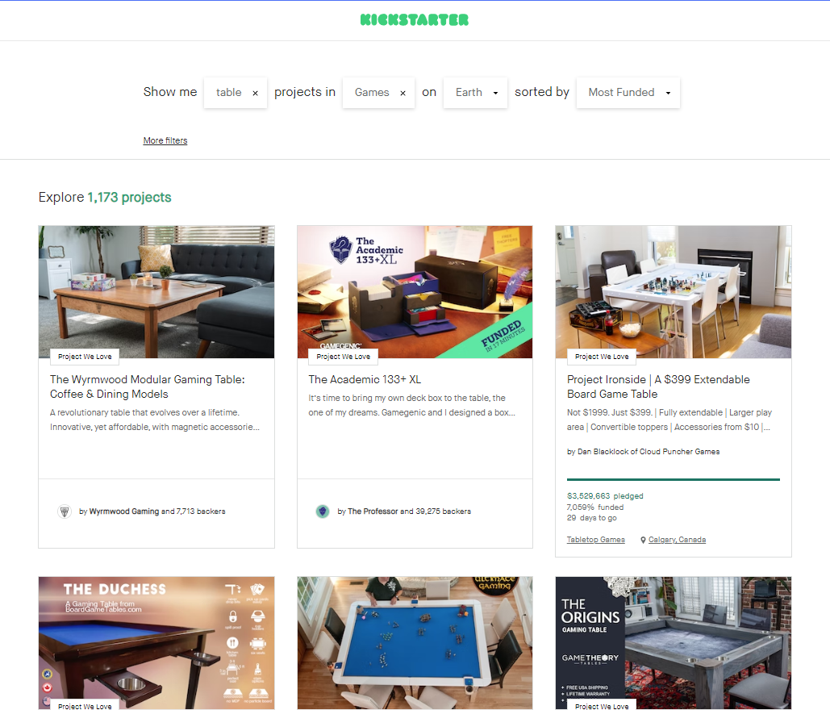
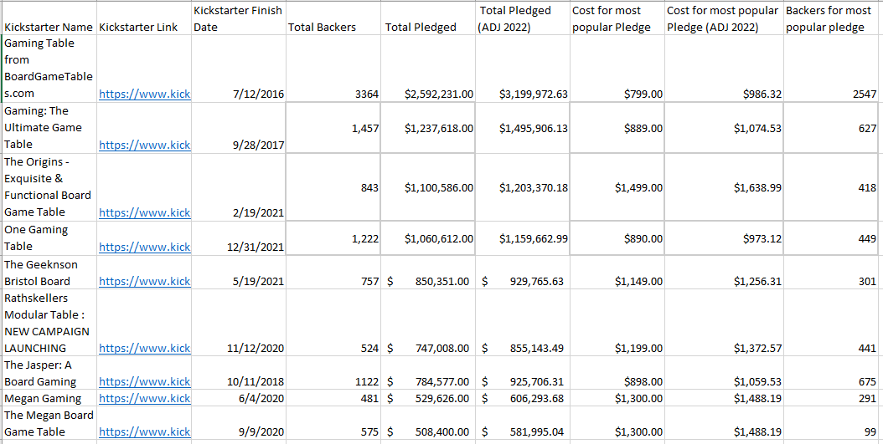
Collect Data
Historical Kickstarters

Slide 4
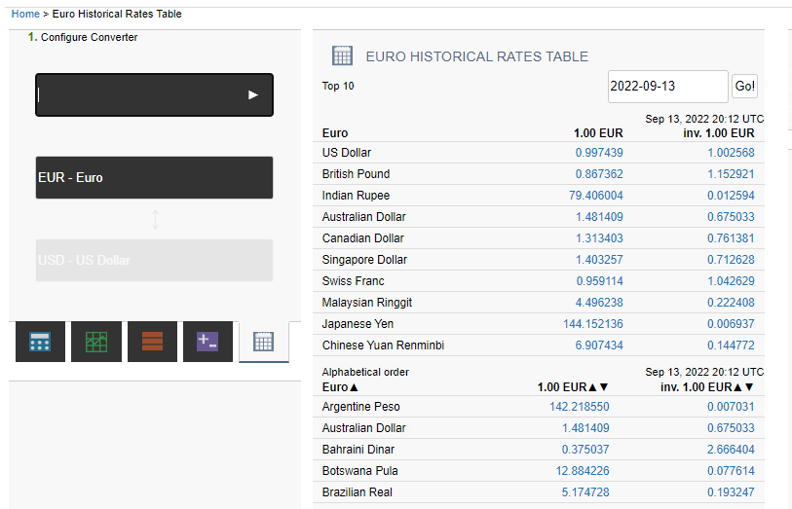
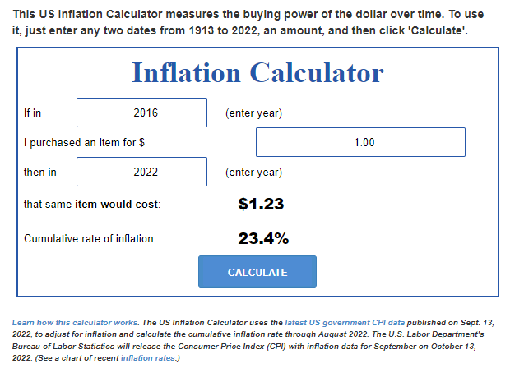
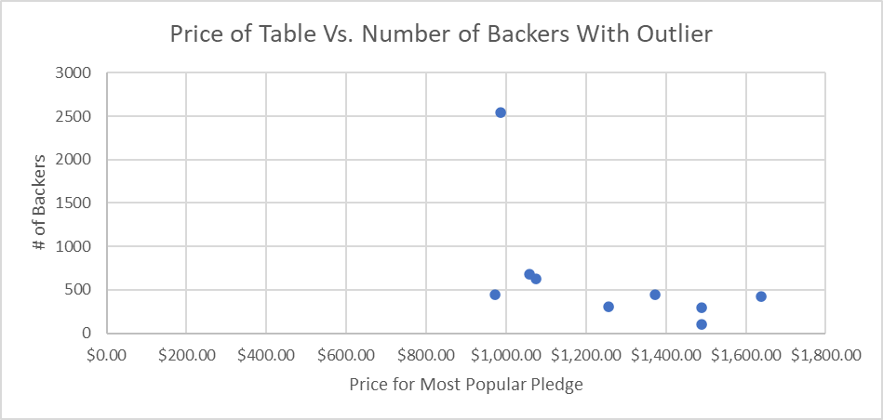
Clean the Data
Problem 1: Pounds vs. USD
Problem 2: Inflation
Problem 3: Data Outlier

Slide 5
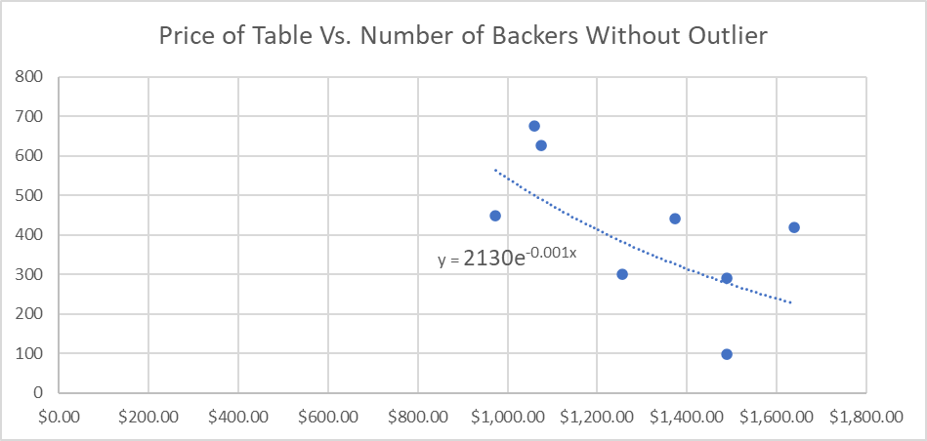
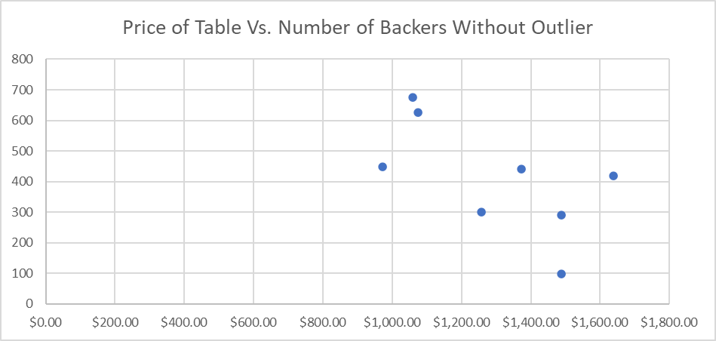
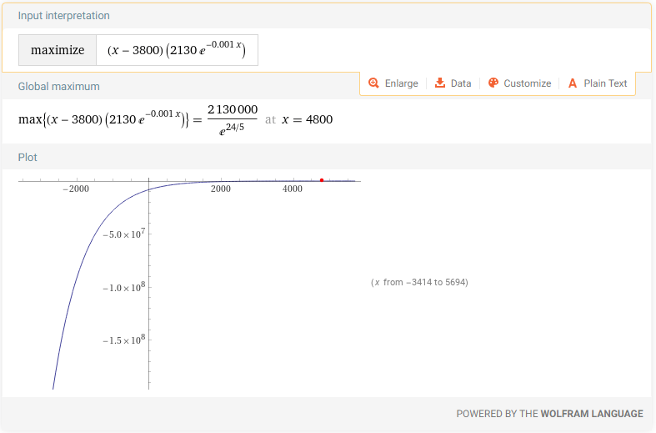
Analyze the data
Profit = Price – Cost OR y = x –3800 (cost to produce Table)
Total Profit = (Price – Cost) * Number of Tables OR y = (x – 3800) * z
Tables Sold = 2130e^(-0.001 * Table Price) or z = 2130e^(-0.001* x)
Total Profit = (x – 3800) * (2130e^(-0.001* x))
Maximum profit when is when x (Table Price) is $4,800 and 17.5 tables are sold

